Slide 1

Super mart Grocery Sales - Retail Analytics:-
Name = Saurav Nair email = sauravnair252@gmail.com

Slide 2
introduction
This analysis explores sales data from Super mart grocery retail to uncover trends, performance insights, and strategic opportunities.
Objectives:
- Understand sales performance across products, regions, and segments.
- Identify profitable categories and key customers.
- Evaluate discount strategies and their impact on profit.

Slide 3
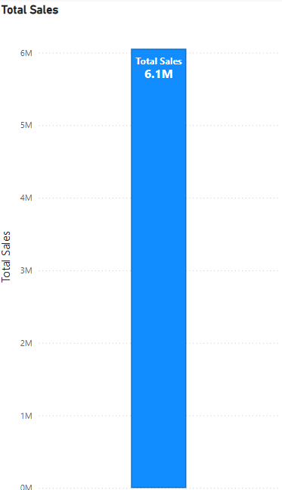
Total Sales: ₹6.1 Million
Super mart achieved total sales of ₹6.1M, indicating a strong market presence and healthy overall demand for grocery products.
High sales volume suggests good product assortment, wide customer reach, and effective sales operations.

Slide 4

Total Profit: ₹1.5 Million
The business generated a total profit of ₹1.5M, showing successful cost management and favorable pricing strategies.
This profit figure suggests that after accounting for costs (like shipping, discounts, and operational expenses), Super mart retains a solid earnings amount.

Slide 5
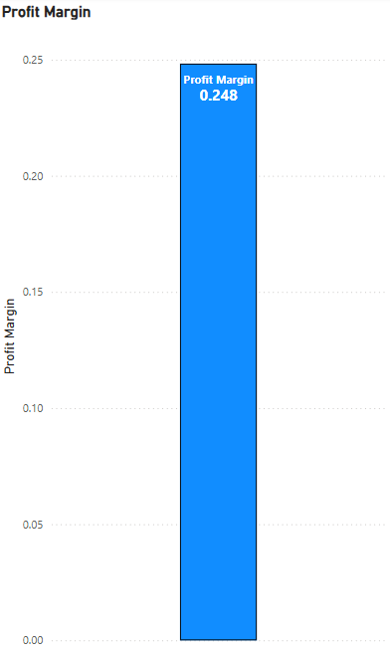
Profit Margin: 24.8%
The profit margin of 24.8% indicates that for every ₹1 earned in sales, ₹0.25 is kept as profit.
This is a healthy margin for the retail grocery industry, where margins can often be lower due to heavy discounting and logistics costs.
It suggests an efficient balance between competitive pricing and cost control.

Slide 6
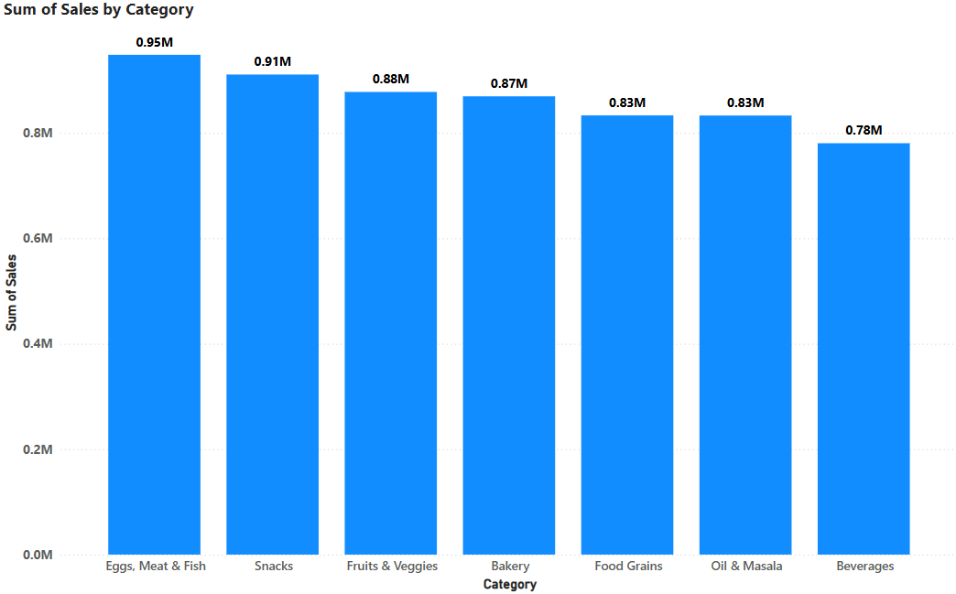
Sales by Product Category
Balanced performance across categories, showing diversified product sales and a well-rounded assortment.
Focus categories like Eggs, Meat & Fish and Snacks can be leveraged for targeted promotions and loyalty initiatives.
Lower sales in Beverages indicate an opportunity to increase awareness or offer combo deals to drive volume.

Slide 7
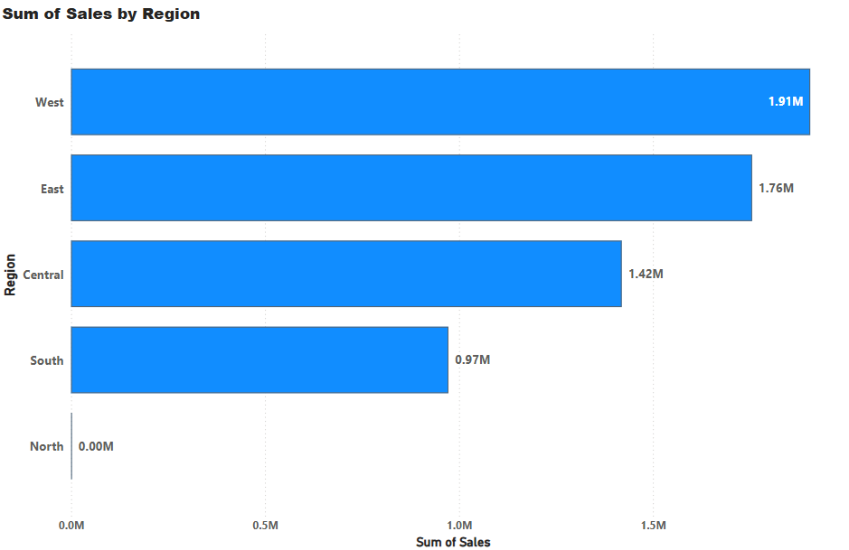
Sales by Region
The West and East regions are the strongest performers, contributing most to overall sales.
Central region has a solid foundation but room for further growth.
South region underperforms relative to its potential — needs strategic focus.
North region could represent a major expansion opportunity if aligned with logistics and market research.

Slide 8
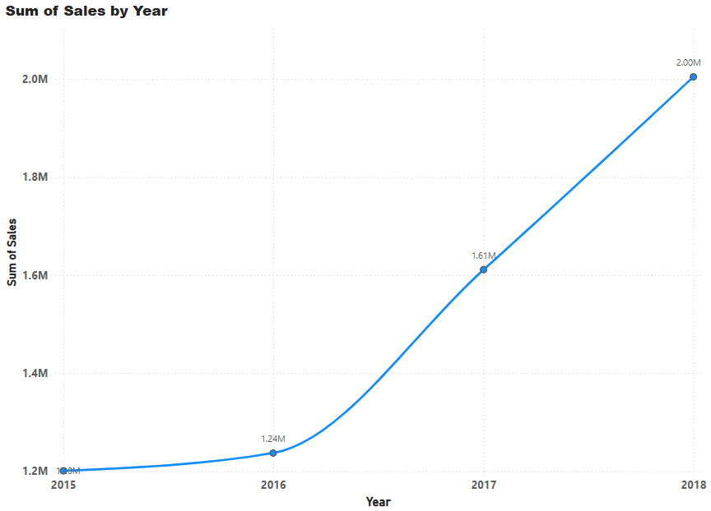
Sales by Region
Consistent and strong growth trajectory, especially from 2016 onwards.
Indicates increasing brand trust, wider market reach, and effective operational scalability.
The sharp rise from 2016 to 2018 suggests successful expansion strategies and potential for further growth in future years.

Slide 9
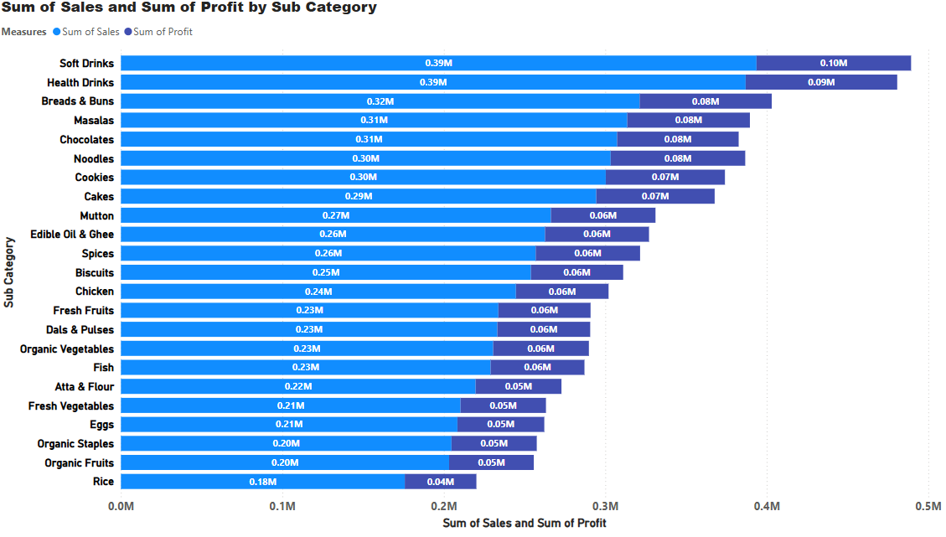
Sales & Profit by Sub-Category
Top sub-categories like drinks and bread contribute disproportionately to both sales and profit, driving overall business performance.
Lower-tier categories, especially rice and some organic items, represent opportunities to either improve marketing or reconsider assortment and pricing.
Steady profit margins across sub-categories suggest good cost control, but focus on boosting volumes in mid and lower segments could further grow profit.

Slide 10
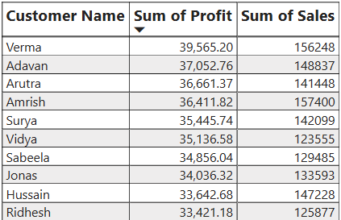
Top 10 customers by Sales and Profit

Slide 11
Thank you

